Slide 1

Department of Biotechnology
School of Bioengineering
SRM Institute of Science and Technology
Kattankulathur
18TP107L - Minor Project
Characterization of Bioactive Compounds of Gymnema Sylvestre and Anti-microbial activity against Escherichia coli
for cellulitis and Streptococcus pneumoniae
Student names with registration no:
Dhanush Sai - RA2111009010235
Pavan Sai - RA2111009010265
Mohith Sai - RA2111009010237
Sriram B - RA2111009010253
Sowmith R - RA2111036010004
Fawaz R - RA2111036010025
Sherin - RA2111009010143
Name of the Guide: Dr.S.Subhashini
Designation : Associate Professor

Slide 2
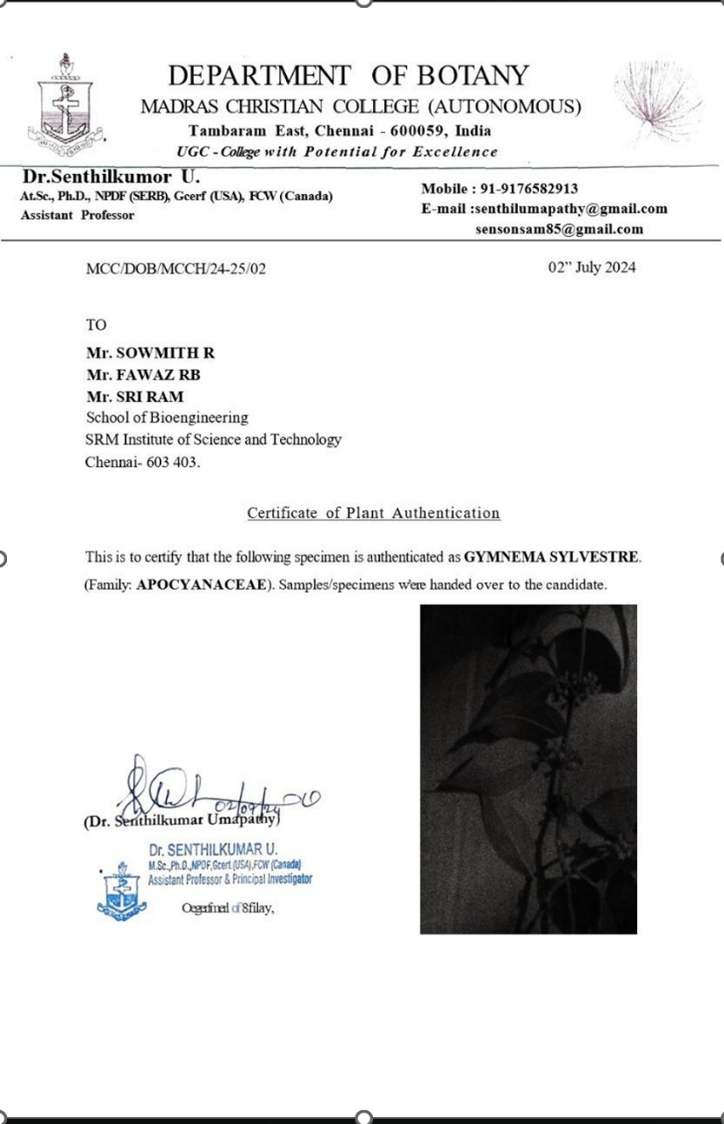
Gymnema sylvestre is a perennial woody vine native to tropical regions of India, Africa, and Australia, widely recognized in traditional Ayurvedic medicine for its therapeutic properties.
It contains saponins, flavonoids, and tannins, which contribute to its medicinal value. Recent research has highlighted its antimicrobial properties, including significant activity against Escherichia coli.
The antimicrobial effect is attributed to the plant’s phytochemicals, which interfere with bacterial cell wall integrity, leading to inhibition of bacterial growth. This suggests that G. sylvestre may have potential applications in treating infections caused by pathogenic bacteria.
Cellulitis is a skin condition brought about by Escherichia coli that causes the skin tissue to become soft and warm which can cause severe complications. Inhibition against Streptococcus pneumoniae is also observed.
INTRODUCTION

Slide 3
LITERATURE REVIEW
S.No | Title | Author/Journal | Observation
1. | Bioactive Compounds from Gymnema sylvestre: Phytochemical and Pharmacological Review | Dhanasekaran D et al. | This review provides an overview of the phytochemical profile of Gymnema sylvestre and its antimicrobial properties, particularly against E. coli infections.
2. | Antimicrobial Properties of Gymnema sylvestre Extracts Against Pathogenic Bacteria | Kumar R et al | The study evaluates the antimicrobial effects of Gymnema sylvestre extracts against various pathogens, highlighting efficacy against E. coli and Streptococcus pneumoniae .
3. | Role of Phytochemicals in the Antimicrobial Activity of Gymnema sylvestre | Singh et al. | This review examines specific phyto -chemicals found in Gymnema sylvestre and their mechanisms of action against E. coli, contributing to antimicrobial efficacy.
4. | Evaluation of Antimicrobial Activity of Herbal Extracts Including Gymnema sylvestre | Patel et al. | This summarizes the antimicrobial properties of various herbal extracts, including Gymnema sylvestre, focusing on their activity against E. coli.

Slide 4
RESEARCH HYPOTHESIS
Ethanolic extracts of Gymnema sylvestre obtained through sonication and microwave-assisted extraction exhibit significant antimicrobial activity, particularly against Escherichia coli and Streptococcus pneumoniae, due to the presence of bioactive compounds such as gymnemic acids, flavonoids, and saponins, which can be characterized and quantified using FTIR, GC-MS, and UV-Vis spectroscopy.
OBJECTIVE
1.Identification and Authentication of Gymnema sylvestre Plant.
2.Optimization of Extraction Methods (Sonication and Microwave-Assisted Extraction).
3.Characterization of Bioactive Compounds Using FTIR, GC-MS, and UV-Vis Spectroscopy.
4.Observation of Antimicrobial Activity Against Escherichia coli and Streptococcus pneumoniae.

Slide 5
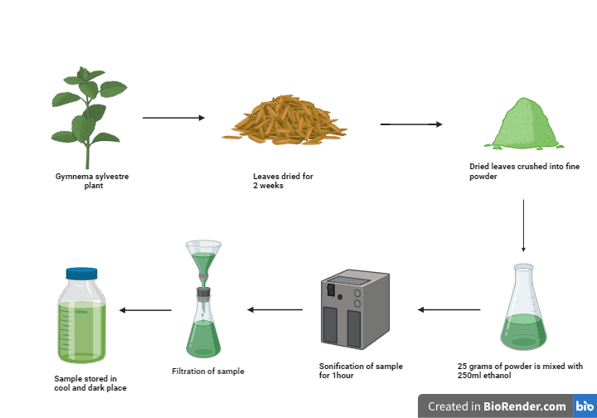
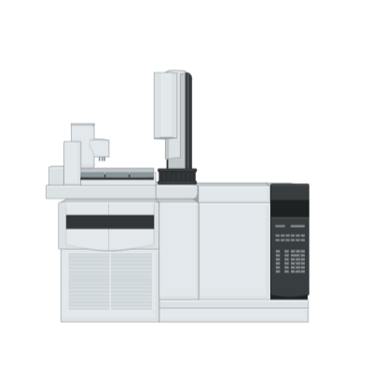
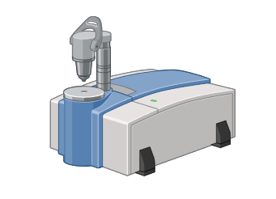
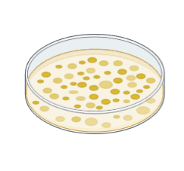

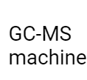

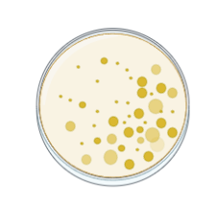
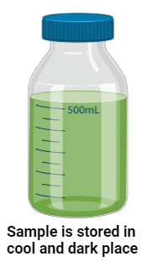
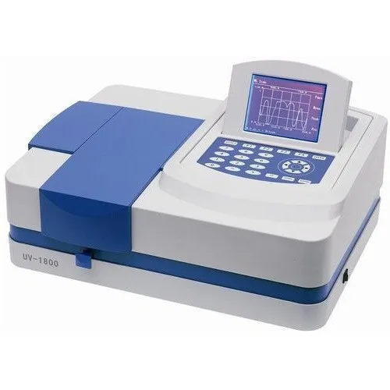

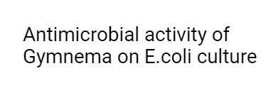
WORKPLAN
Extraction
Characterization
Growth Inhibition Assay
Crude extract was obtained through process of UltraSonication from mixture containing ethanol along with the powdered sample
Bioactive compounds in Gymnema are analysed using FTIR, GC-MS, and UV-Vis Spectroscopy
Antimicrobial activity is observed through Growth Inhibition Assay on E.coli and Streptococcus pneumoniae

Slide 6
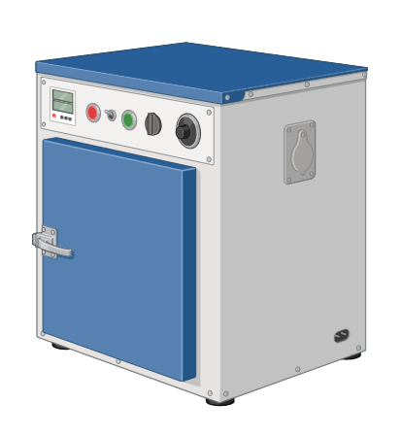
METHODOLOGY
Extraction
The sample was shade-dried
at room temperature for 2 weeks
The dried leaf sample was then crushed and made into fine powder
20 g Leaf powder + 500 ml of 70% Ethanol is mixed
Gymnema sylvestre plant is collected on identification and authentication
The mixture is then filtered using whatman paper and the resulting mixtures were collected
The resultant mixture is sonicated at 20-40 kHz on 30-40* C for 1.5 hrs with stirring at regular intervals
Sample was placed in hot air oven for 5 hrs at 60 degrees celsius
The mixture is then incubated in a cool,dark place.

Slide 7
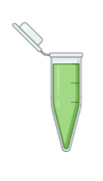

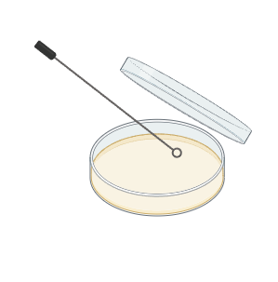
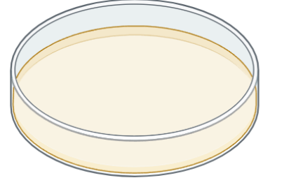
METHODOLOGY
Antimicrobial activity
Wells are punched with a sterile cork borer or tip.
Microbial inoculum is spread over the agar plate with a sterile cotton swab.
Extract is dispensed into wells
25 ml of growth medium is poured into a Petri dish and let is made to solidify under UV light.
Antimicrobial growth is observed based on the growth of inhibition zone and its diameter

Slide 8
Review 1 – Question and Answer
What is the common name for your plant Gymnema sylvestre ?
Gurmar
2. Why have you chosen Ethanol ?
Ethanol was chosen because it can extract both polar and nonpolar compounds resulting in high yields.
3. Why was 70% Ethanol chosen particularly ?
Seventy percent was chosen because pure ethanol would not be as soluble as 70% ethanol,having the remaining percentage of water allows it for easy cell wall dissolution.
4. What are the alternative methods for ultrasonication?
Hot and cold maceration and magnetic stirrer.

Slide 9
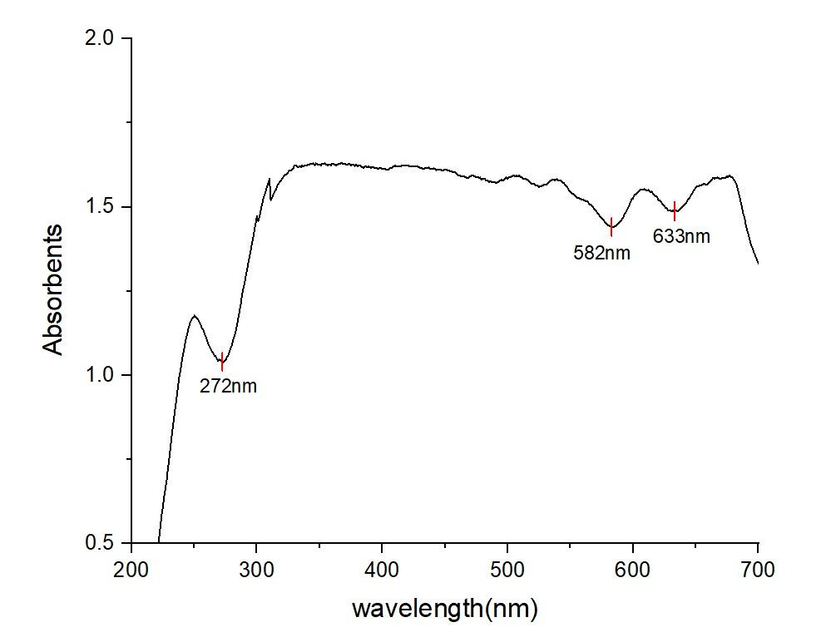
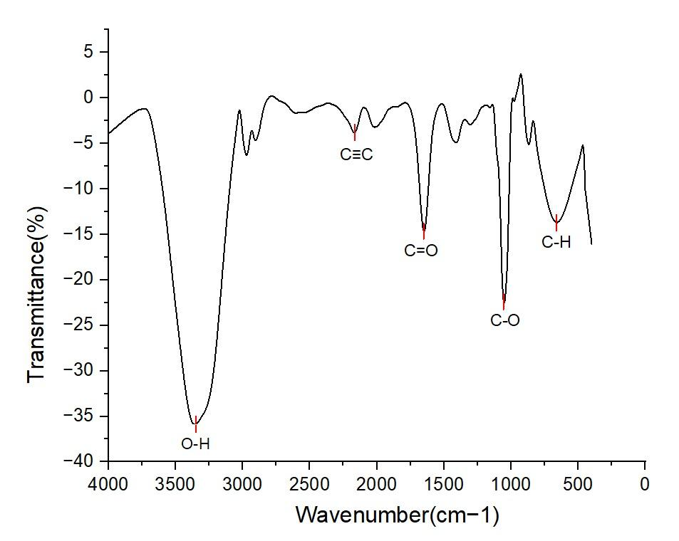
RESULTS
UV spectroscopy
Fourier Transform Infrared Spectroscopy

Slide 10
RESULTS
Gas chromatography-Mass Spectrometry
S.No | Compound Name | R.T (MIN) | Molecular formula | Molecular weight | Total %
1. | 3-Penten-2-one, 4-methyl- | 3.567 | C6H100 | 98.14 | 0.25
2. | 1,2,3,4-CYCLOHEXANETRIOL | 13.694 | C6H12O4 | 148.16 | 4.79
3. | Inositol, 1-deoxy- | 17.002 | C6H12O5 | 164.16 | 17.17
4. | 2,4-Pentanedione, 3-butyl- | 10.342 | C9H16O2 | 156.22 | 0.14
5. | TETRADECANAL | 24.450 | C14H28O | 212.37 | 0.06
6. | Phytol | 20.729 | C20H40O | 296.53 | 2.28
7. | Lidocaine | 18.848 | C14H22N2O | 234.33 | 0.60
8. | Propane, 1,1,3-triethoxy- | 8.615 | C9H20O | 176.25 | 1.27
9. | Oxirane, octyl- | 18.720 | C10H20O | 156.27 | 0.02

Slide 11
RESULTS
S.No | Compound Name | R.T (MIN) | Molecular formula | Molecular weight | Total %
10. | Dibutyl phthalate | 18.135 | C16H22O4 | 278.32 | 0.22
11. | n-Hexadecanoic acid | 19.243 | C16H32O2 | 256.42 | 4.79
12. | Bis(2-(Dimethylamino)ethyl) ether | 22.313 | C8H20N2O | 160.26 | 17.17
13. | Neophytadiene | 20.179 | C9H16O2 | 296.53 | 0.14
14. | TETRADECANAL | 22.450 | C14H28O | 212.37 | 0.03
15. | Octacosanoic acid, 2,4,6,8-TETRAMETHYL-, METHYL ESTER | 23.332 | C33H64O2 | 492.86 | 2.28
16. | 2(4H)-BENZOFURANONE, 5,6,7,7A-TETRAHYDRO-6-HYDROXY-4,4,7A | 17.525 | C8H8O3 | 152.15 | 0.60
17. | 2,6,8-TRIMETHYLBICYCLO[4.2.0]OCT-2-ENE-1,8-DIOL | 17.691 | C10H16O2 | 168.23 | 1.27

Slide 12
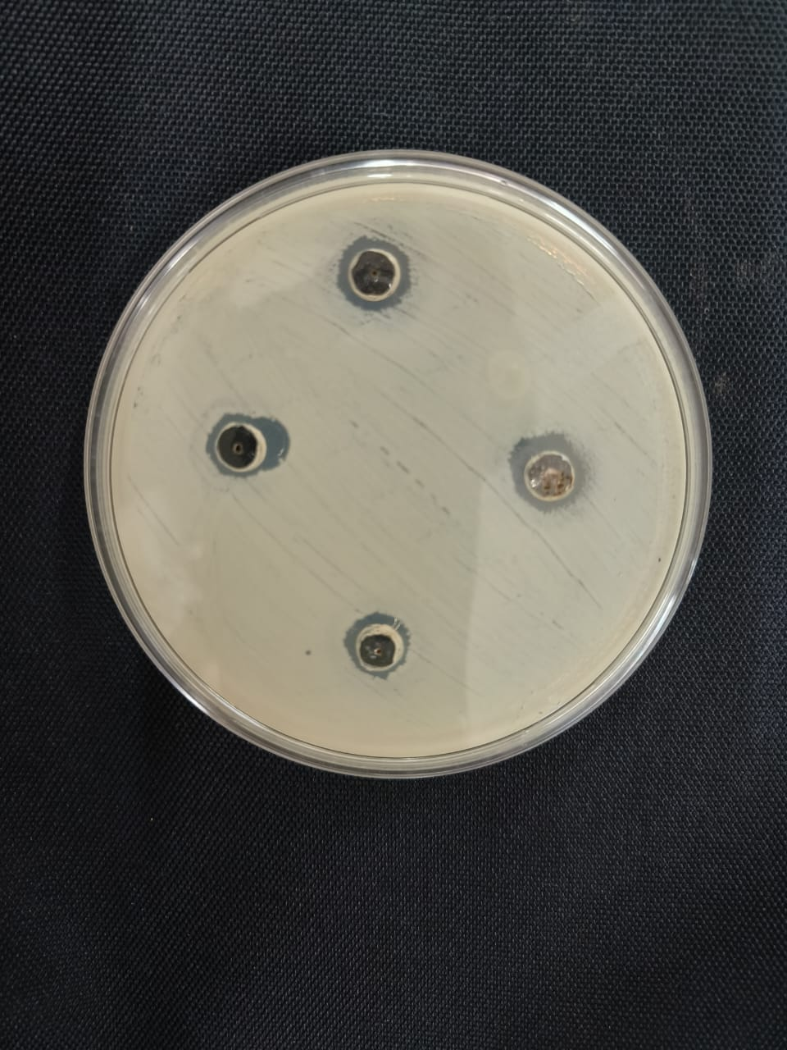
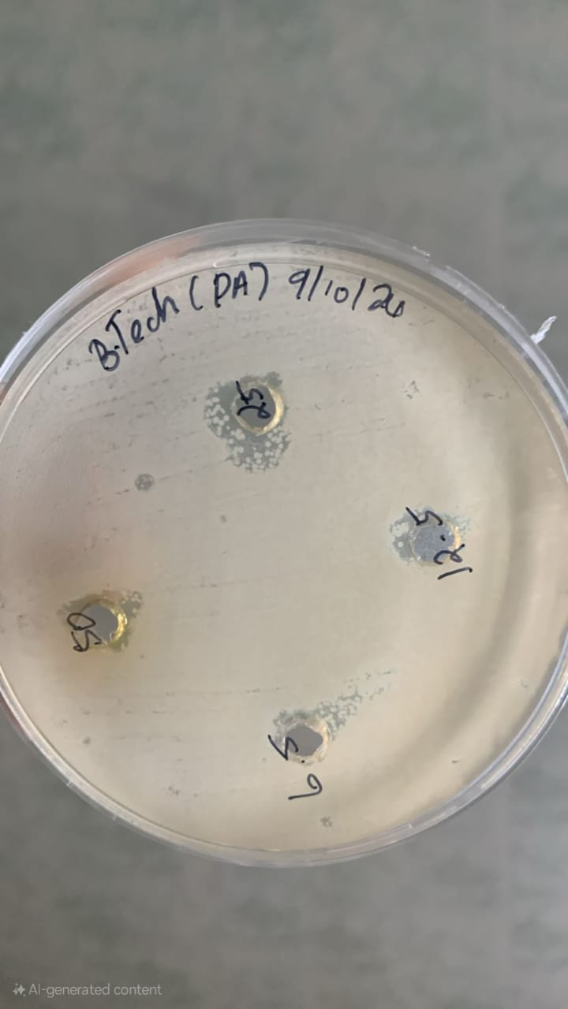
RESULTS
12.5 mg
S.No | Microorganism | Zone of Inhibition
1. | Escherichia coli | 6.5 mg - 8mm 12.5 mg - 9mm 25 mg - 9mm 50 mg - 10mm
2. | Streptococcus pneumoniae | 12.5 mg - 8mm 25 mg - 11mm 50 mg - 8mm
6.5 mg
50 mg
25 mg
25 mg
12.5 mg
12.5 mg
50 mg
6.5 mg
Streptococcus pneumoniae
Escherichia coli
The diminished growth of Escherichia coli and Streptococcus pneumoniae around the dispensed walls in the agar medium is observed on addition of extract, proving the antimicrobial properties of Gymnema sylvestre.

Slide 13
Research output
This research concludes that the bioactive compounds present in the Gymnema sylvestre extract demonstrate antimicrobial properties, particularly against E. coli. The characterization methods (GC-MS, FTIR, UV-Vis) help identify the specific compounds responsible for this activity, while the growth inhibition assay confirms the extract's effectiveness in reducing bacterial growth.
This research could contribute to the development of natural antimicrobial agents derived from plants which help in treatment of microbe based diseases like Cellulitis and also gram positive bacteria like Sterptococcus pneumoniae.

Slide 14
SUMMARY
Different compounds of Gymnema sylvestre like flavonoids,saponins, gymnemic acid,triterpenoids were characterized by their peak values upon forming graphs of their test data
Extraction from Gymnema sylvestre to obtain usable sample with the help of ultrasonicator and hot air oven
After characterization of compounds the sample extract was then added into a petri plate comprising of Escherichia coli colony and Sterptococcus pneumoniae colony on an agar media.
After incubation it is observed that there is inhibition of the colony near the sample indicating that Gymnema sylvestre does stop the growth proving it to have antimicrobial activity.

Slide 15
REFERENCES
1.Dhanasekaran, D., & Thirumurugan, K. (2018). Bioactive Compounds from Gymnema sylvestre: Phytochemical and Pharmacological Review. Journal of Medicinal Plants Research, 12(12), 178-185.https://www.researchgate.net/publication/260131983_Phytochemical_and_Pharmacological_Properties_of_Gymnema_sylvestre_An_Important_Medicinal_Plant
2.Kumar, R., & Patel, V. (2020). Antimicrobial Properties of Gymnema sylvestre Extracts Against Pathogenic Bacteria. Asian Journal of Pharmaceutical Sciences,15(5),414-421.
https://www.researchgate.net/publication/8997881_Antimicrobial_activity_of_Gymnema_sylvestre_leaf_extract
3.Singh, A., & Joshi, R. (2021). Role of Phytochemicals in the Antimicrobial Activity of Gymnema sylvestre. Phytochemistry Reviews, 25(2),275-290.
https://www.researchgate.net/publication/271137016_Phytochemical_analysis_and_antibacterial_activity_of_Gymnema_Sylvestre_leaf_extracts
4.Patel, S., & Nair, J. (2022). Evaluation of Antimicrobial Activity of Herbal Extracts Including Gymnema sylvestre. International Journal of Current Research, 14(3), 312-319.https://www.researchgate.net/publication/314978600_EVALUATION_OF_ANTIMICROBIAL_ACTIVITY_OF_GYMNEMA_SYLVESTRE
5. Abhilash, P., & Devanand (2023).Antimicrobial activity of Gymnema sylvestre leaf extract.International Journal of Current Research,12(12),275-278.https://pubmed.ncbi.nlm.nih.gov/14630178/
6. Tiwari, P., & Mishra.B (2014).Phytochemical and Pharmacological Properties of Gymnema sylvestre: An Important Medicinal Plant. National Library of Medicine,14(11),112–116.https://pmc.ncbi.nlm.nih.gov/articles/PMC3912882/

Slide 16
THANK YOU

